Slide 1
IS SS
20 17
PUBLIC DATA BASE for SYSTEMS PROCESSES THEORY & SYSPATH*
*Youth & Retirement caused most co-authors not to travel to Wien: THUS THIS TALK GIVEN BY DR. PAMELA BUCKLE-HENNING
Richard Emerson, SE Retired, Jet Propulsion Labs, remerson9@gmail.com
Richard Martin, President, Tinwisle Corporation, Bloomington, Indiana, richardm@tinwisle.com
Prof. Len Troncale, Past President, ISSS, 1990, Lecturer, M.S. in S.E., College of Engineering, Calif. State Polytechnic Univ., Pomona, lrtroncale@cpp.edu

Slide 2
CONTENTS/OUTLINE I.
Era of BIG DATA finally reaches GST Research
Estimating the Current and Near Future Amount of Info in the SPT
Anticipated SPT DataBase Features
Features Derive from the Internal Structure of, & Linkages in SPT
Who Will Populate the SPT Database? Where?
Staffing; Funding (Wilson Grant, INCOSE Foundation Grant)
A Sample of MxN Matrices → DB
Items in Info Categories for each SP; SP LP’s with other SP’s;
Who Will Use the SPT-DB? For What Uses?
Imaging the Users and Stakeholders; How Might They Use It

Slide 3
ERA OF BIG DATA & GST: INFO WEALTH OF SPT

Slide 4
ESTIMATE – SPT INFOQUANTITY for searches across both the natural and human literature
Search Engine (all 1980-2010) | Total # Articles | Divided into these subcategories
PUBMED | 14,931,000
BIOABSTRACTS | 9,894,125 | Problem of redundancies & ways to correct for
IEEE Xplore | 2,610,748
GEOREF | 3,388,706
PsychInfo, SocioAbs | 3,297,910
Econolit & ABIInform | ca. 36,390,000
Total = ~67M
PhySci = 10M; Living = 23M; Human = 39M

Slide 5
ESTIMATE – SPT INFO QUANTITY for just our physical file of reprints for just one ISP
DDT’s | ORIGIN PROCESSES | Divided into these subcategories of origin
ASTRONOMY | 362 | asteroids; moons; planets; stars; galaxies; cosmos
PHYSICS | 5 | many
CHEMISTRY | 5 | compounds; organic molecules; biopolymers;
GEOLOGY | 18 | continental plates; mountains; weather; rocks;
BIOLOGY | 153 | Many from prebiotic protocells to all cell types of multicellular organisms to ecology
MATH & COMPUTER SCI | 0 | Does occur; origin of each new type of math & computer language
HUMAN SYSTEMS | 80 | Origins of all levels of social organism to human society & civilization
…from peer-reviewed natural sci journals such as…
Total = 623; with PhySci = 390; Living = 153; Human = 80

Slide 6
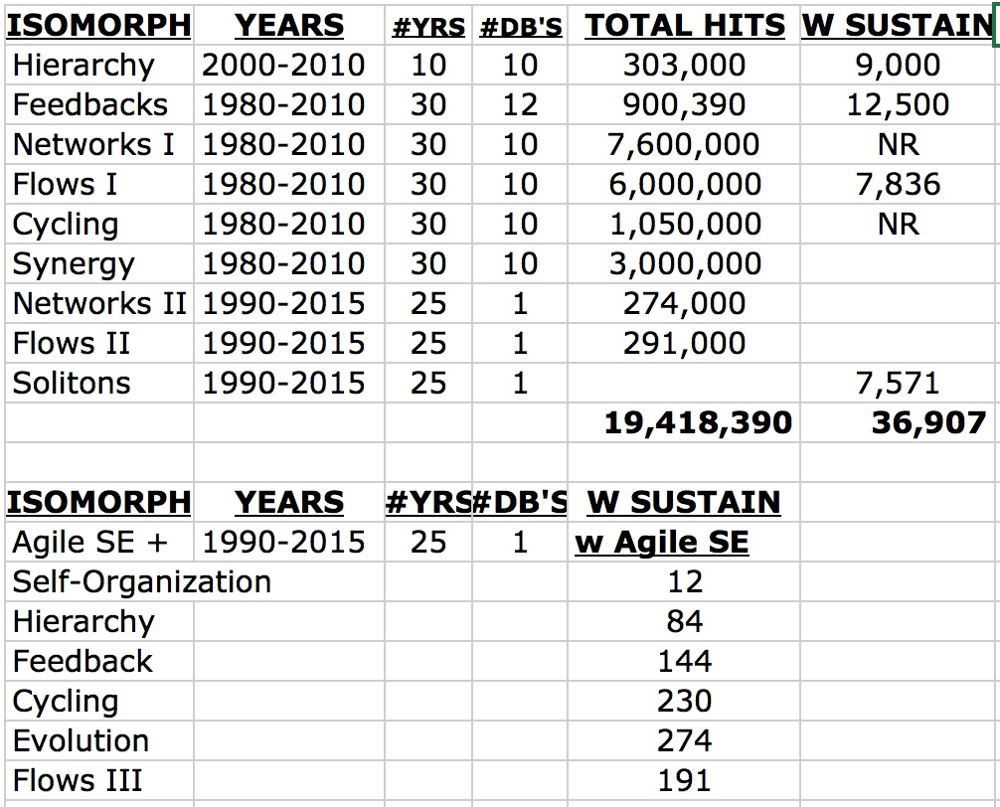
Some examples of student searches for seven ISP’s for years covered by one search engine
Though “hits” are way too many to be practical, more restricted search terms give more manageable sets
I usually advise them to only look for texts, reviews, and chapters.

Slide 7
NATURAL SCIENCE LIT: BIG #’s CASE STUDIES PER ISP PER DISCIPLINE
But it is not only the usual natural sciences that serve as a source of info for our new sys of sys process theory, it is the new systems-based versions of those sciences. They have recently discovered their obligate complex systems natures
© Dr. Len Troncale, June, 2010

Slide 8
FEATURES OF A RELATIONAL DATABASE FOR SPT

Slide 9
SUMMARY OF 30 INFORMATION CATEGORIES: KEY INFO FOR EACH SPT-ISP
QUICK INTRO EXAMPLES OF ISP
BRIEF HISTORY OF ISP
IDENTIFYING FEATURES OF ISP
IDENFITYING FUNCTIONS OF ISP
TYPES & TAXONOMY OF ISP
DISCINYMS OF THE ISP
KEY DISCRIMINATIONS ON ISP
EVIDENCE FOR THE ISP (Science)
PROOF OF PROCESSIVITY / ISP
PREREQUISITES, DEPENDENCIES
LINKAGE PROPOSITIONS OF ISP
DYSFUNCTIONS /or/ PATHOLOGY
SELECTED KEY SOURCES
FUTURE RESEARCH QUESTIONS
LOGO’s, ICON’s, MODEL SYMBOLS
MEASURABLES FOR THIS ISP
CURRENT CONSENSUS FINDINGS
COMPARATIVE USE IN GST/ST/SS
FAQ FOR THIS ISP
ISSUES INVOLVING THIS ISP
USE IN CONVENTIONAL DOMAINS
KEY FUNDING AGENCIES FOR ISP
EQUATIONS & FORMALIZATIONS
TOOLS & TECHNIQUES FOR ISP
EXEMPLARS OF APPLICATIONS
KEY WORKERS FOR THIS ISP
KEY INSTITUTIONS FOR ISP
BIBLIOGRAPHY/LITERATURE
COMPARATIVE WORD DEFINITION
OBSTACLES TO >USE OF ISP

Slide 10
Reprint Holdings & ISSS Archive I.
Consistently, for three decades, Dr. T. and students have collected reprints from mostly Science and Nature
The two most read interdisciplinary science journals in the world; publ. in USA and UK; 100,000’s
Publishing in Science, for example, is regarded in US as the epitome of a scientific career
Only those articles reporting scientific experimental results on one of the systems processes or linkage propositions were selected
Each selected article was classified on three levels
To the Isomorphic Systems Process or Linkage Proposition it represented
To the Natural Science reporting (astronomy, physics, chemistry, geology, biology, compsci, math)
To the phenomena that it represented in conventional research (cont drift; photosyn; physiol; quantum)
Numbers per file are uneven because depended on what was published
But at build-out, that would mean 110 file SETS, each with 7 folders for each of the six natural sciences and one for the human sciences, and this would = 770 folders
2

Slide 11
Reprint Holdings & ISSS Archive II.
Nearby (10 mi; 20 min), at California State Polytechnic U. in Pomona, Ca. there resides the first physical Archive of the ISSS
Housed in the campus library Special Collections Unit
Combined with the Reprint Collection at the Wilson office, science & engineering collection at the nearby Honnolds Library (Claremont Colleges) & the Cal Poly Library this may be one of the most concentrated collections on systems anywhere in the world
An image of the Holdings of the ISSS Archive (reported in ISSS Bulletin,
All the General Systems Yearbooks (Vol I to XXX)
Almost All the ISGSR and ISSS Bulletins (1960 to present)
Many of the ISGSR and ISSS Conference Proceedings
Collections of the Behavioral Science Journals before becoming SRBS
Videotapes of key lectures and discussions and plenaries and Miller Founder interviews
2

Slide 12
Reprint Holdings & ISSS Archive III.
In pure total numbers for each, reported in the ISSS Bulletin, we have…….
More than 10,000 pages
More than 1,000 authors
More than 700 topical systems keywords
2

Slide 13
WHO WILL POPULATE the SPT DATABASE? And WHERE?

Slide 14
Who Will Populate the SPT Data Base? I.
Three current grants will provide staffing etc. totaling ~$40,000 of value
Wilson Trust and Current Office (2-year feasibility test)(see montage of pics next slides)
Office rent; Office furniture; Office equipment; Utilities; Supplies; Security;
232 Harrison Ave., Claremont, Ca. 91711; two houses away from 8-campuses of Claremont Colleges
Two INCOSE Development Grants (in partnership with INCOSE SSWG & NSWG)
One to support initiation of the SPT-RDB; Second to support initiation of the ISSP
California State Polytechnic University Foundation, Troncale overhead funds & account
SO CORE study group established & guaranteed
Undergraduate Work/Study student help = 4 students, each 10 hours/wk, so 40 hrs/wk for two academic years plus half-time Dr. Troncale (volunteered) plus additional volunteers and any graduate students who elect to use facilities or database
Agreement between Wilson Trust and ISSP
Common office for Wilson website production; SPT website activities, and International Business Office for the new Int’l Society for Systems Pathology (ISSP)
NSF?; Templeton?; Gates?
Future grantsmanship potential
Plan open DB & gaming & iCloud or Crowdsourcing features.
2

Slide 15
Who Will Populate the SPT Data Base? II.
Intend to hire four Work/Study students in Fall for one year each
One student will work 10 hours per week on programming & populating its database
Design & Programming will be supervised by two systems engineers Richard Emerson & Richard Martin
Frequent feedback from users (see next slide) will characterize this period
Second student will work 10 hours per week on Int’l Society for Systems Pathology (ISSP)
Please attend next paper session, this conference, for information on formation of the new ISSP
Third student will work 10 hours per week on the website for Albert G. Wilson, past ISSS member and participant; this work will be entirely for the Wilson Trust
But much of Wilson Trust work will also finds its way into the SPT-RDB because of the late Wilson’s interests in GST and Systems science
Fourth student will work 10 hours per week purely on the Systems Processes Theory
And that student will be also populating the SPT relational data base
These students, with Dr. T., will form the core of 1.5 person years of research and input over this next coming year; will be interesting to see productivity
But we assume there will be at least a dozen systems scientists and systems engineers supplementing their efforts
2

Slide 16
TRELLO PLANNING METHOD for the SPT-RDB

Slide 17
What is Trello? (Trello.com)
Besides the usual DB design, management, and programming tools & techniques, our team (Emerson, Martin, Troncale) decided to use Trello for early planning
Trello is a free web based program (premium version available) which electronically simulates a collection of bulletin boards containing
Lists which contain
Cards which contain
Descriptions of tasks
Conversations, questions and answers
Checklists
Due dates, assignments and status
Links to additional information
Cards can be moved between lists and boards
Lists can be moved between boards

Slide 18
Examples of Trello mgmnt boards and lists cards
Group Projects or tasks
Writing a paper or book

Slide 19
Example Conversation Card

Slide 20
Why Use Trello?
Supports, simplifies, enables, real-time collaboration
Maintains a detailed History of activities & their sequence
Supports any process which can be represented by information on cards in lists on boards
Can implement
Task management
Work flow
Chats
Kanban
Agile
Customer service tracking
Simple and free; so very good cost:benefit ratio

Slide 21
Example Trello Uses
I (Emerson) have used Trello for:
Customer response system—emails are logged and distributed to agents
Software system development
Project management
Conference management
Requirements collection, validation and management

Slide 22
Current Trello Stats for SPT-RDB Project
Team of Emerson & Troncale first started face-to-face meetings (1/mo.)
But for frequent updates, too infrequent; Trello makes for much more frequent and directed
Total number of cards created so far (~53) for the SPT-RDB Design Project in the following lists
Incoming (new tasks)……….1
Issues (broader concerns than tasks)……….3
high priority (tasks that need to be done first)……….12
low priority (later tasks in critical path)……….15
in process (tasks currently in progress)……………..8
Waiting (for assignment)…………..1
Done (tasks from any list that are completed)……….13
Lists can be added, dropped and rearranged as activity changes

Slide 23
M by N (MxN) MATRICES for the SPT-RDB

Slide 24
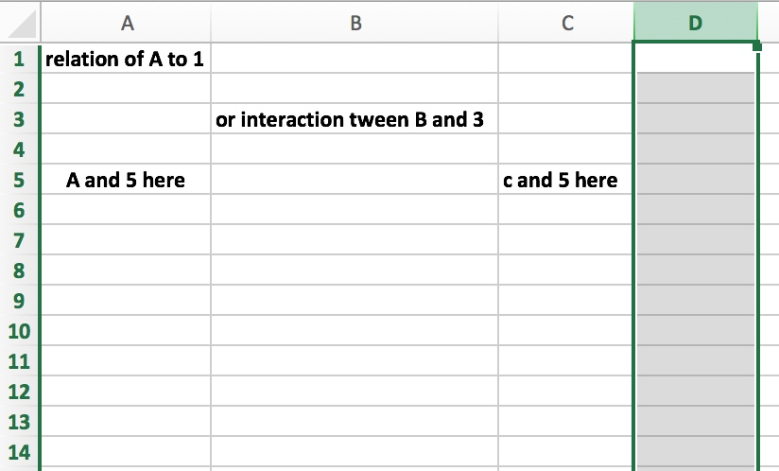
M by N or MxN Matrices To Build SPT-DB I.
Can use series of these matrices in 2D to begin data capture
Like Excel spreadsheets: each interstice is interaction between “M” and “N”
Advantages
well known
easy to use
can include very large amounts of data
organizes data by choice of axes
if we use clever strategy, meaningful juxtaposition brings meaning to data
Can build networks of related information by expanding beyond 2D

Slide 25
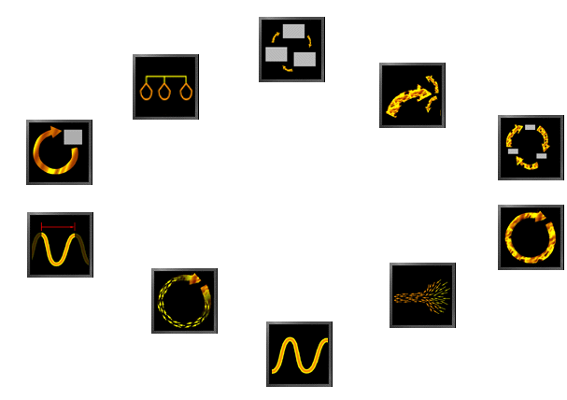
MxN (means M by N) Matrices To Build SPT-DB II.
 | CASE STUDY ONE | CASE STUDY TWO… | …CASE STUDY 100
IDENTIFYING FEATURE ONE | X | X | X
IDENTIFYING FEATURE TWO …TO ALL FEATURES | X |  | X
IDENTIFYING FUNCTION ONE…to all FUNCTIONS |  | X | X
Recall the piece of a crucial MxN chart in the recent talk? It showed when (X) any particular case study (instantiation) or (phenomena) exhibited by science exp’t’n that one ID feature or function was indeed present. That is also what this icon symbol below stands for.
DOES EACH CS SHOW ALL F&F’s

Slide 26
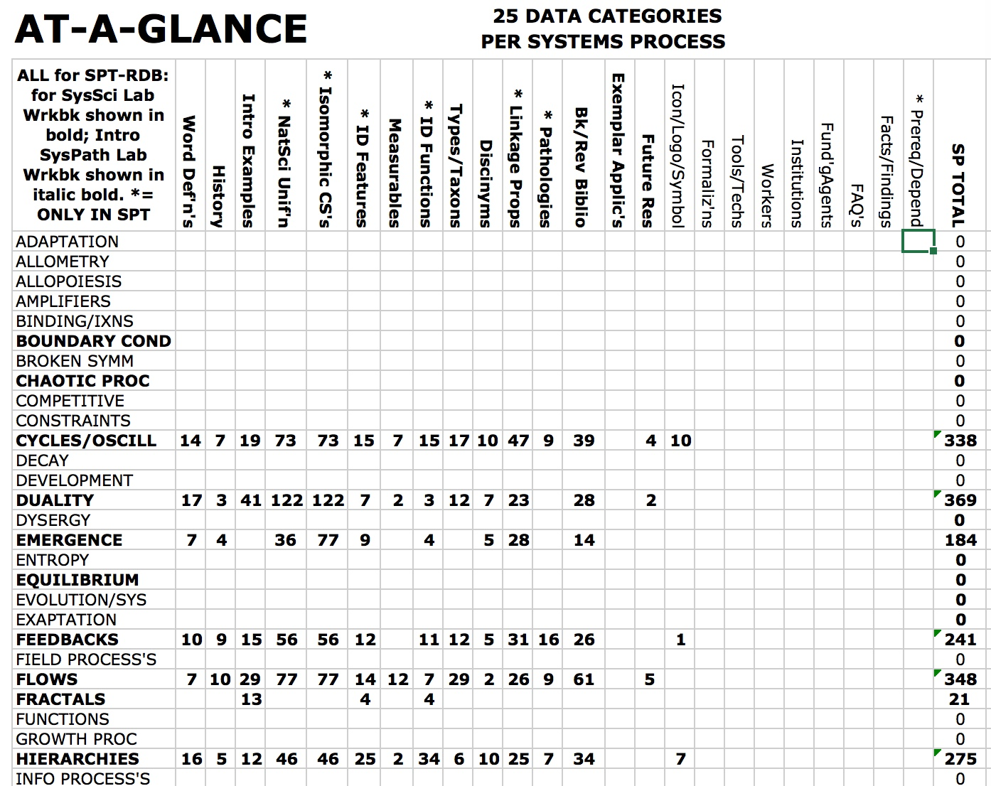
M by N III.
Era of BIG DATA finally reaches GST Research
These are actual numbers of items we have for just 15 selected info categories of the 30 planned
And then only for six ISP’s (shown in bold)

Slide 27
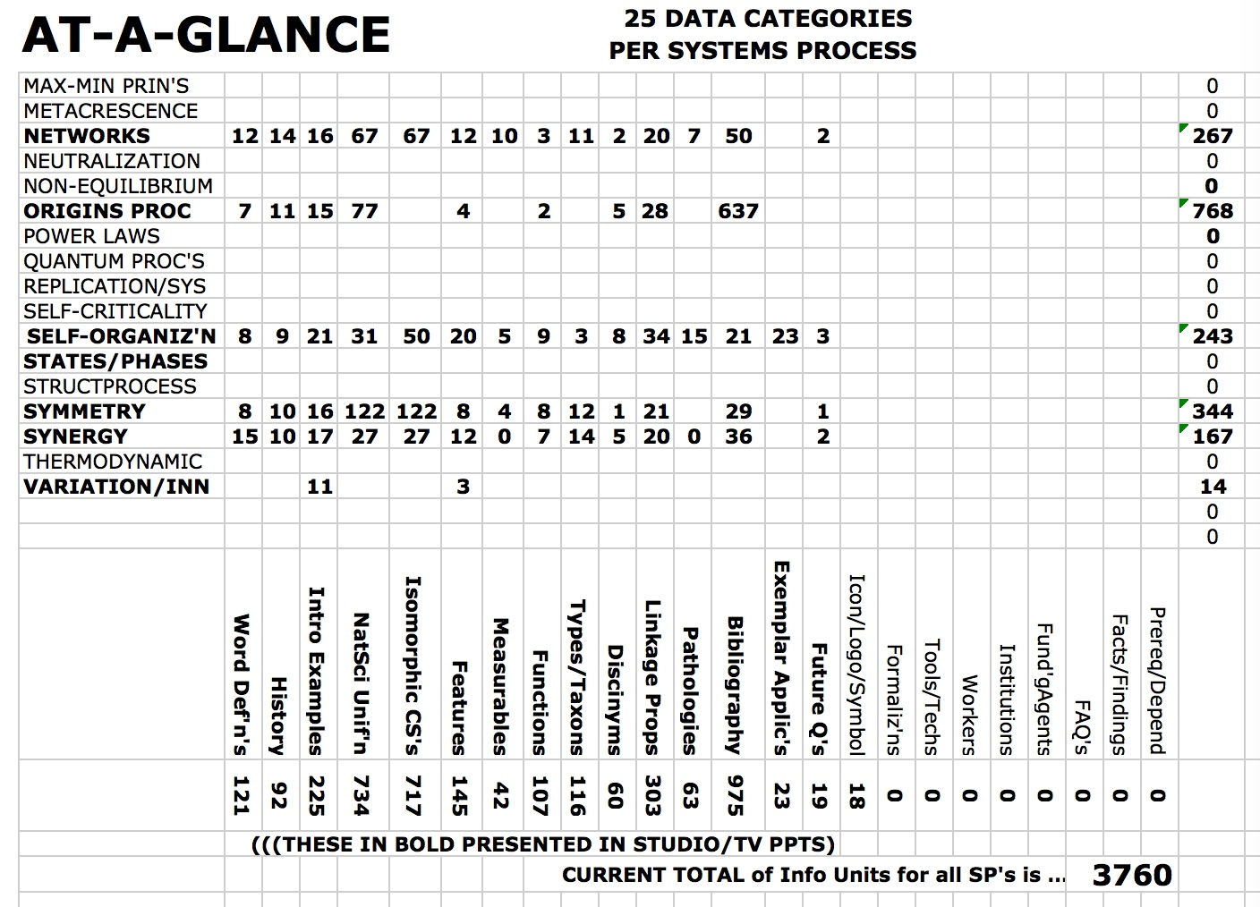
M by N IV.
Era of BIG DATA finally reaches GST Research
These are actual numbers of items we have for just 15 selected info categories of the 30 planned
And then only for five more ISP’s (in bold)
Altogether nearly 4,000 info items

Slide 28
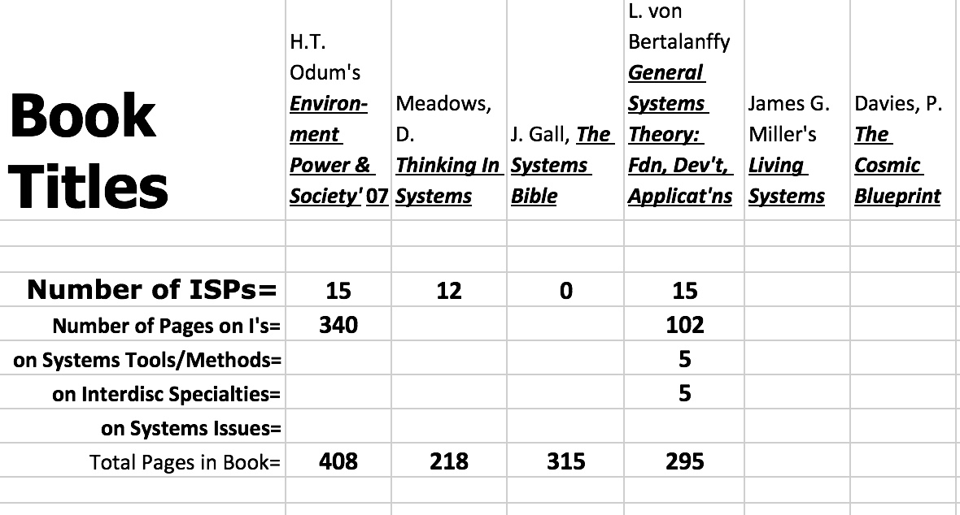
M by N or MxN Matrices To Build SPT-DB V.
Era of BIG DATA finally reaches GST Research
Different authors have included different numbers of ISP’s in their work
We have many more indices studied than these few illustrations

Slide 29
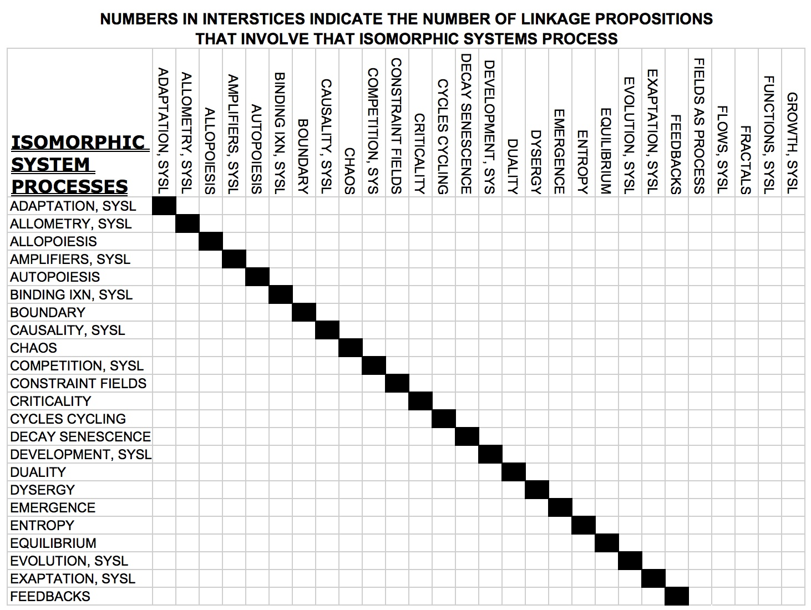
MxN VI.
Era of BIG DATA finally reaches GST Research
We have literally hundreds of linkage propositions not yet entered
Troncale has a weakness for at-a-glance summations of complexity

Slide 30
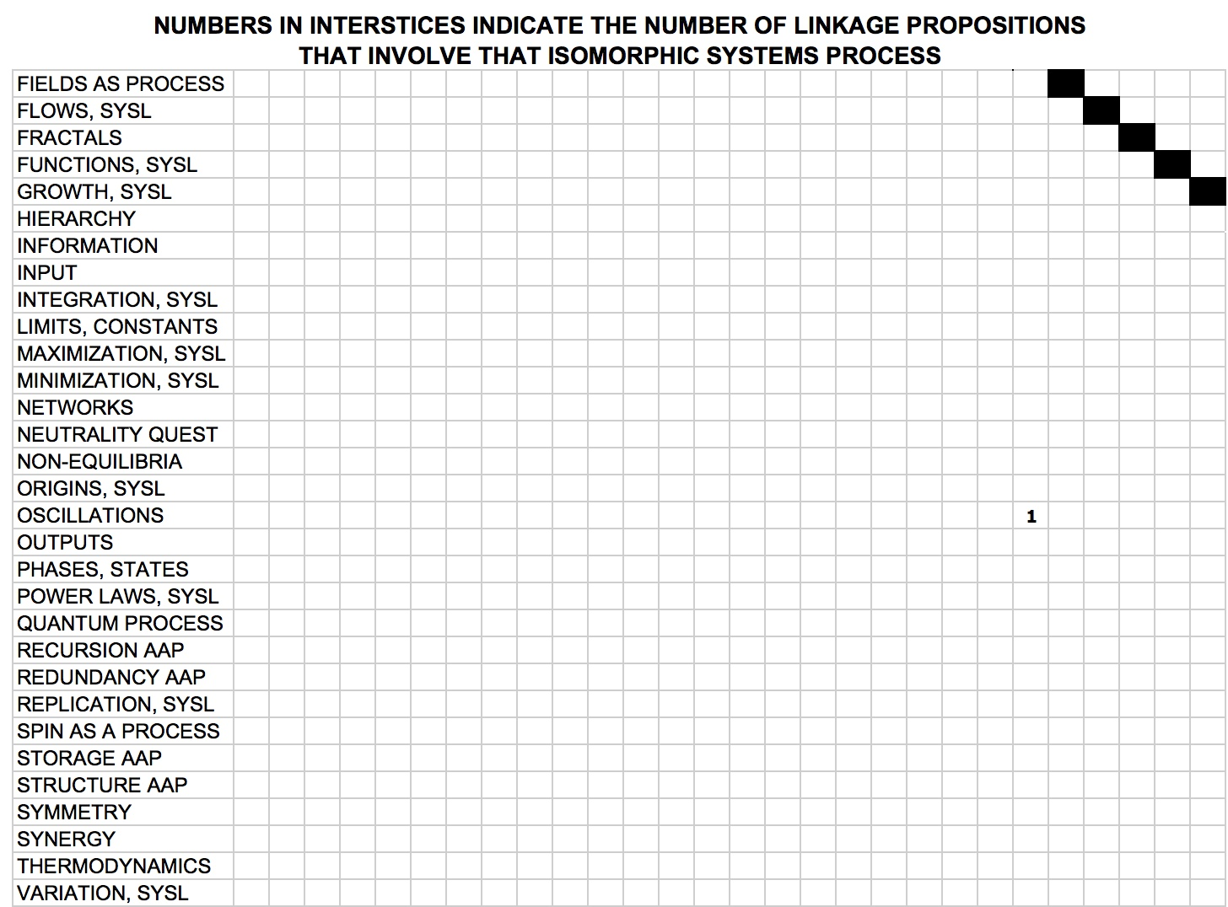
MxN VII.
Era of BIG DATA finally reaches GST Research
Helps estimate the Current and Near Future Amount of Info in the SPT
Will show at-a-glance where we have too few interactions to remedy by research

Slide 31
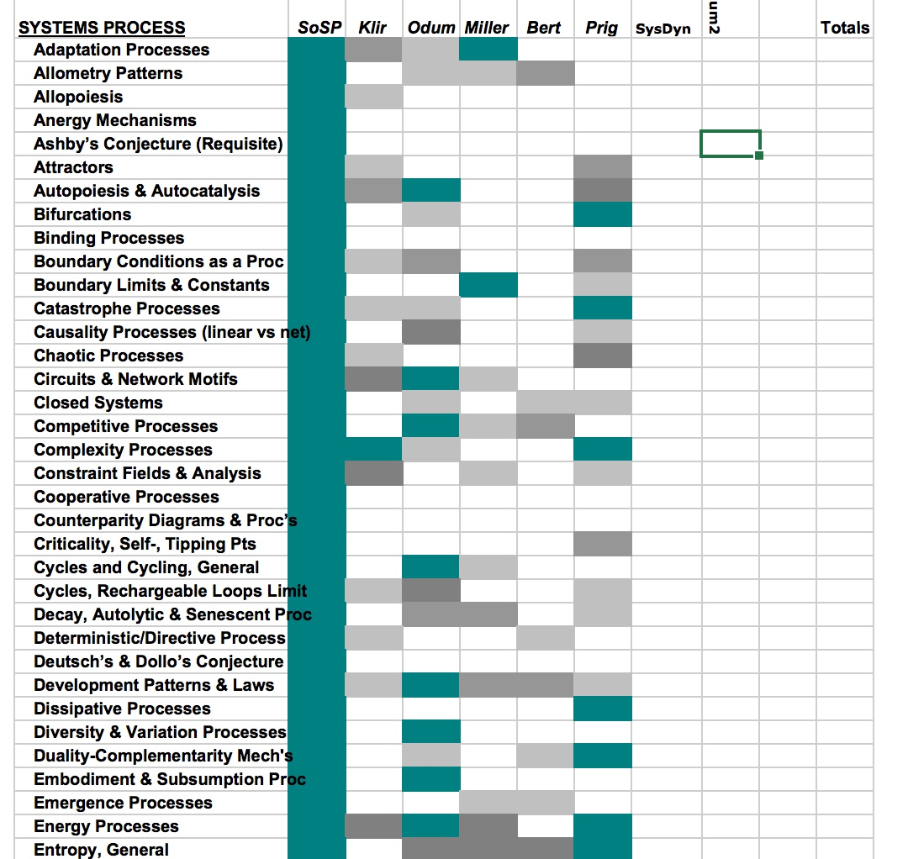
MxN VIII.
Era of BIG DATA finally reaches GST Research
Imagine graduate students being able to access such a chart on the data base where there is not only a graded color density shown but the actual pages cited for each isomorph in each text
Then if they wanted to read up on say “fractals” they could just read the appropriate parts of the appropriate texts
Again we have many more done on this but not yet entered

Slide 32
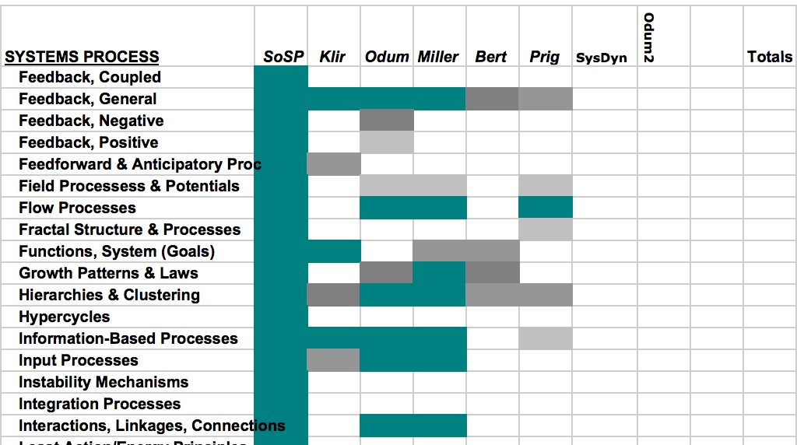
MxN Matrices To Build SPT-DB IX.
Era of BIG DATA finally reaches GST Research
Notice that this usage or resource helps answer the earlier question of whether to keep the list lumped into only 55 ISPs or keep it as the candidate 110
Look at “feedbacks” If clustered to only fdbk one loses a lot of resolution

Slide 33
WHO WILL USE the SPT-RDB? FOR WHAT?

Slide 34
Who Will USE the SPT Data Base? I.
Members of the Systems Science Community
Members of the Systems Engineering Community
Members of the Systems Thinking Community
All these three because the will find uses for its vast archives of targeted data on systemness
Members of the new Systems Pathology Community (5+ major domains)
Because it will contain so many guidelines for better design and curation of systems
Members of the Sustainability Community
Members of the Systems Design and Service Communities
Educators from all levels of education
Because systems education will penetrate K-12 (see SD) to UG college (see ISGE) to now Grad edu
Conventional Established Communities
Some natural scientists because SPT is so tightly linked to sci lit & numerous natural phenomena
New systems-based specialties like Systems Biology, Earth Systems Sciences, CAS Physics
Some engineers from other engineering specialties because of its Systems Mimicry spin-off
Philosophers? Authors? Opinion Leaders? Law, Legislation, & Public Policy?
2

Slide 35
For What Will They USE the SPT Data Base? II.
Recall the definition and meaning of Linkage Propositions (LP’s) in the SPT
Redefined in the next slide for reminder
Recall that the early Founders of GST did not use anything like the formalized LP’s
See the clustered categories of “operators” defining types of interaction between two or more isomorphies
Recall that these define in great detail the underlying causes, non-linear causes, of systems dynamics
Then the following slides show multiple ways in which the users can ask for various specific alternative aggregations of LP’s for different purposes and restricted to specific kinds of
Right now we are doing these by hand; but with the entire SPT-RDB digitized there is no reason that users cannot do it at will because the SPT-DB will ”know” the connections
Ultimately we would like the SPT graphics to allow users to actually fly thru the LP diagrams to click on or find whatever dynamic they need to look at
Like in some of our best science fiction movies today, but in terms of systems knowledge
First let us look at some of the categories of LP influence operators, & then some alternative graphics
2

Slide 36
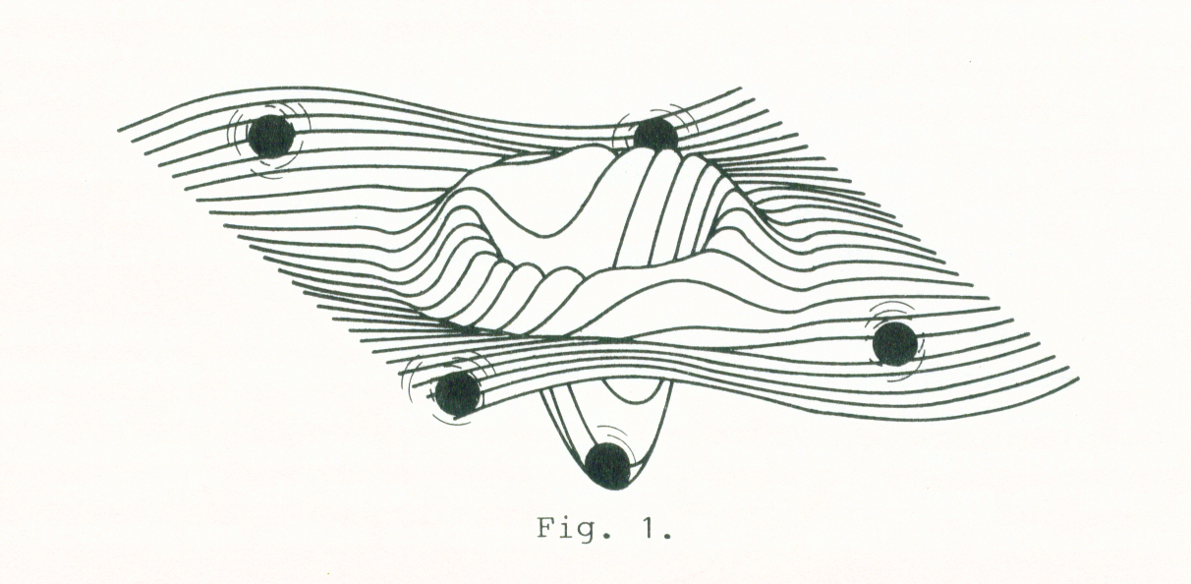
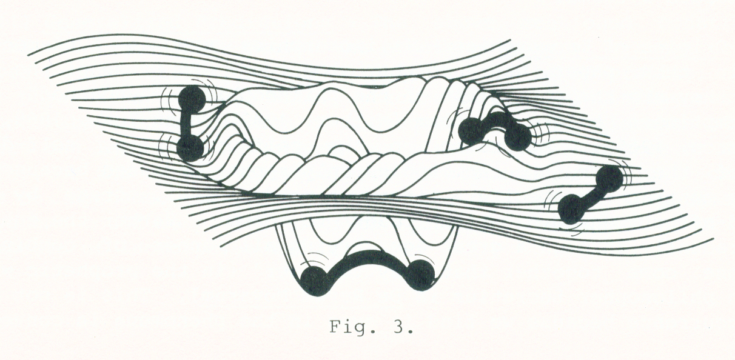
What are Isomorphic Systems Processes (ISPs)?
& Linkage Propositions (LPs)?
An I. Systems Process (ISP) describes an obligate sequence of transformation steps that fulfills a necessary systems function (isomorphic because found similar across many systems)
Natural sciences = phenomena = natural processes; ISP abstraction of all processes
Like “algorithms” in computer science, but may never finish
Precise, well-defined, limited set of step-by-step rules or operations to change a defined input to a defined result or finish
These are the spheres in the following diagrams of many isomorphies connected by LP’s
Natural Systems Processes Theory (SPT) – integrates – based on 100 ISP’s; many phenomena into ONE
LP’s are language-based or formal statements of a documented & described influence between two or > ISP’s
Can show graphically by node & link diagrams
Different types can be shown by diff’t lines
Linkage Proposition stating mutual influence
I. Systems Process A
Operator Phrase Describing Influence
I. Systems Process B

Slide 37
Lines between ISP’s are Linkage Propositions each having an “operator” defining the influence between them; makes SPT nets
Congruence/commonality relationship:
“can substitute for;” “is analogous/homologous to;” “is isomorphic to (*); “is the same as;” “is identical to;”
Linear or conventional ordering relationship:
“is, in part, the cause of (*);“ “is, in part the result of (*);““contributes to;” “is a partial function of;” “acts among/or! within;” “is a condition necessary for;” “probabilistic influence on;” “increases;” “decreases”
Dual opposite relationship:
“is a counterparitor to (*);“ “is a symmetrical counter to” (note the duality aspect of several entries in the other relationship categories; for example, increase/vs/decrease, or cause/effect);
General/specific ordering relationship:
“is a type of;” “sub/super;” “micro/macro;”
Inversion/or/reciprocality relationship:
“negates;” “opposes;” “enhances;” “inhibits;” “increases;” “decreases;”

Slide 38
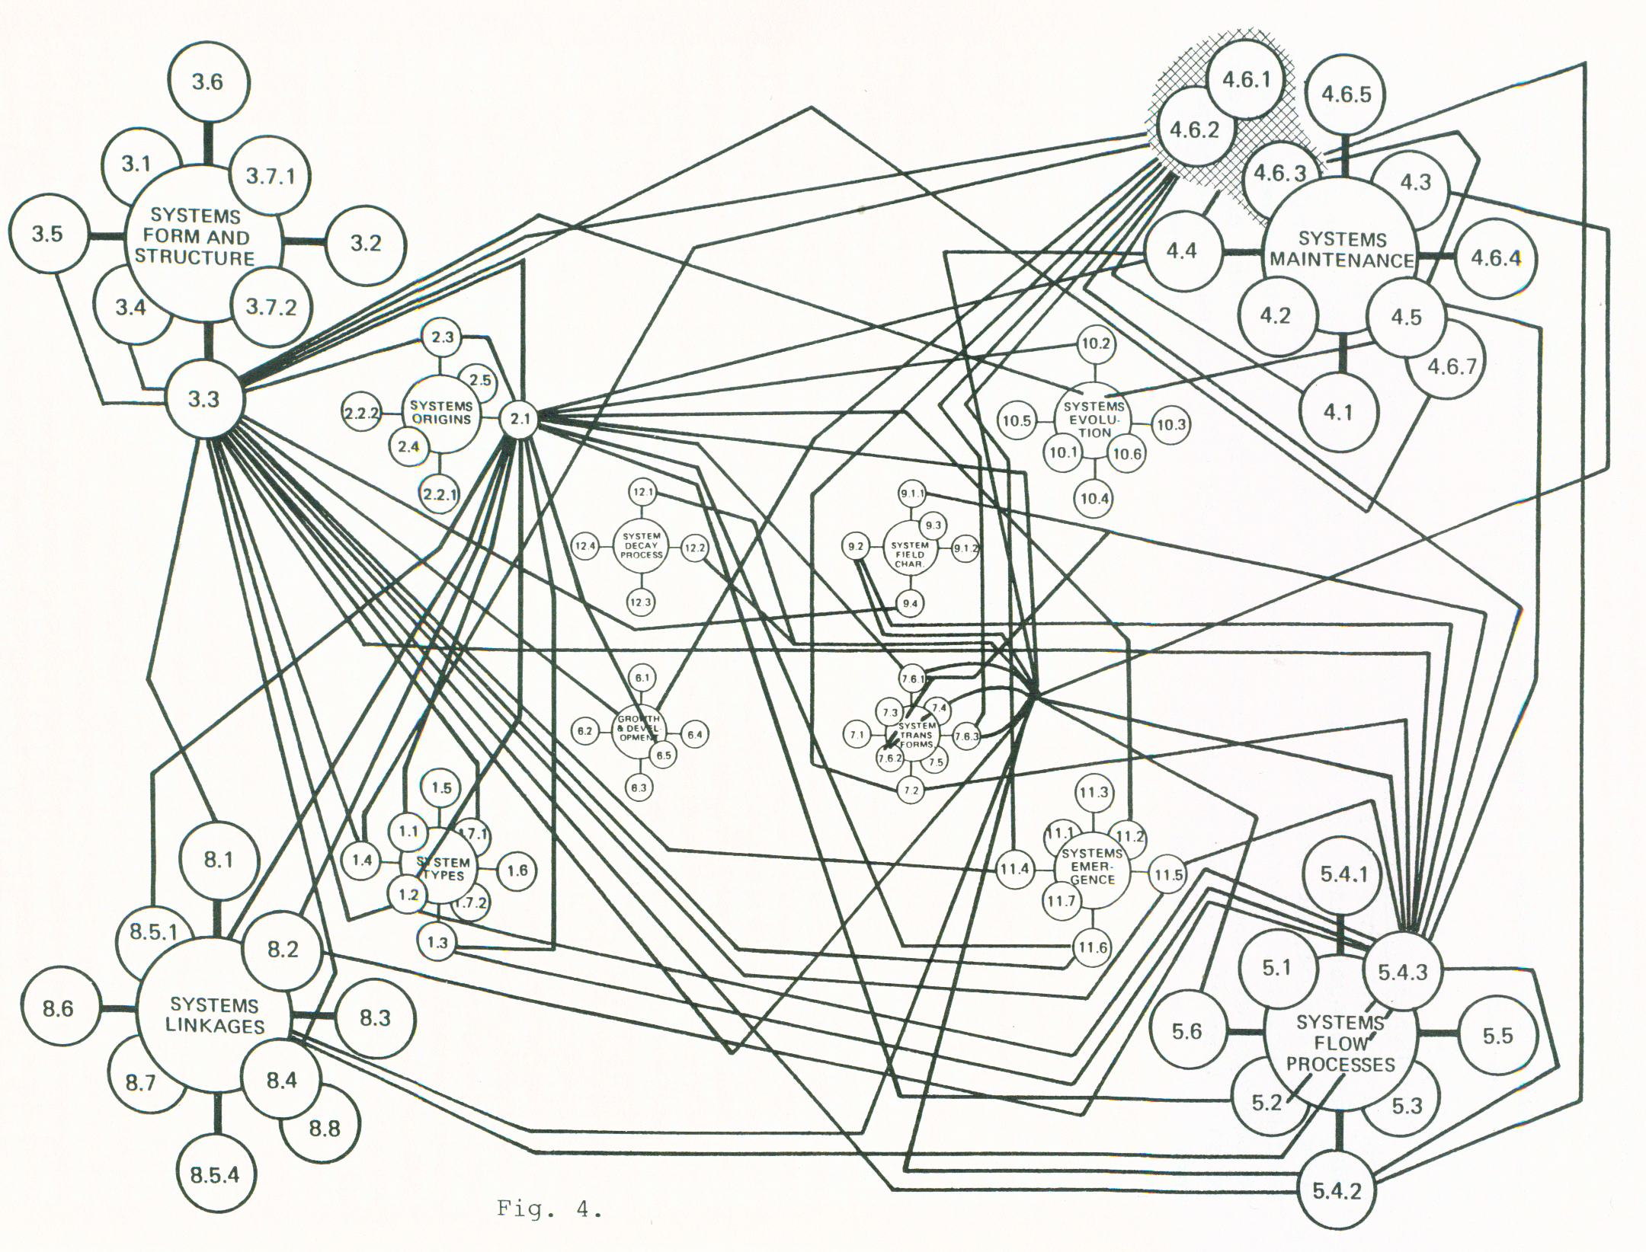
Association Classes of LP’s: Based on Operators
When ISP’s joined with LP’s yields…
Instead of the multitude of overlapping lines of mutual interaction shown in the systems-based interactive graphs, one could ask the database to show only one association class of linkages, or show each class as a different type of interaction line as shown in the lines above.
Recognition of these “association classes” has much utility; a different type of line connector could be used to show different association classes; users could ask for only one type of line (association class); or for only one ISP LP’s as in next slides ………..
Diagrams summarize and teach.
…an extremely rich abstract model of how systems work – in general

Slide 39
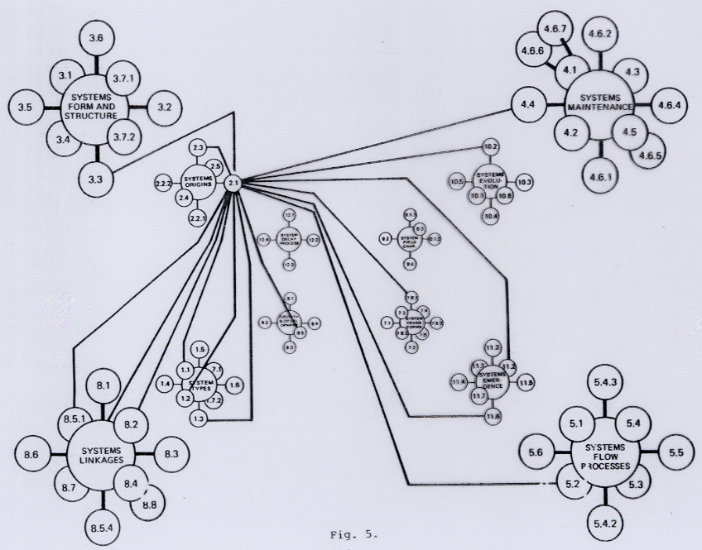
For example, this request was for only those linkage propositions wherein sys process 2.1 (duality mechanisms) either influenced or were influenced by other sys processes…..
Can click on any sphere or line to find out the data base info on that part of graph
In this way, the overall SPT NET is a graphic organization of the data + way to get to data + an
At-A-Glance simplification of the massive data sets

Slide 40
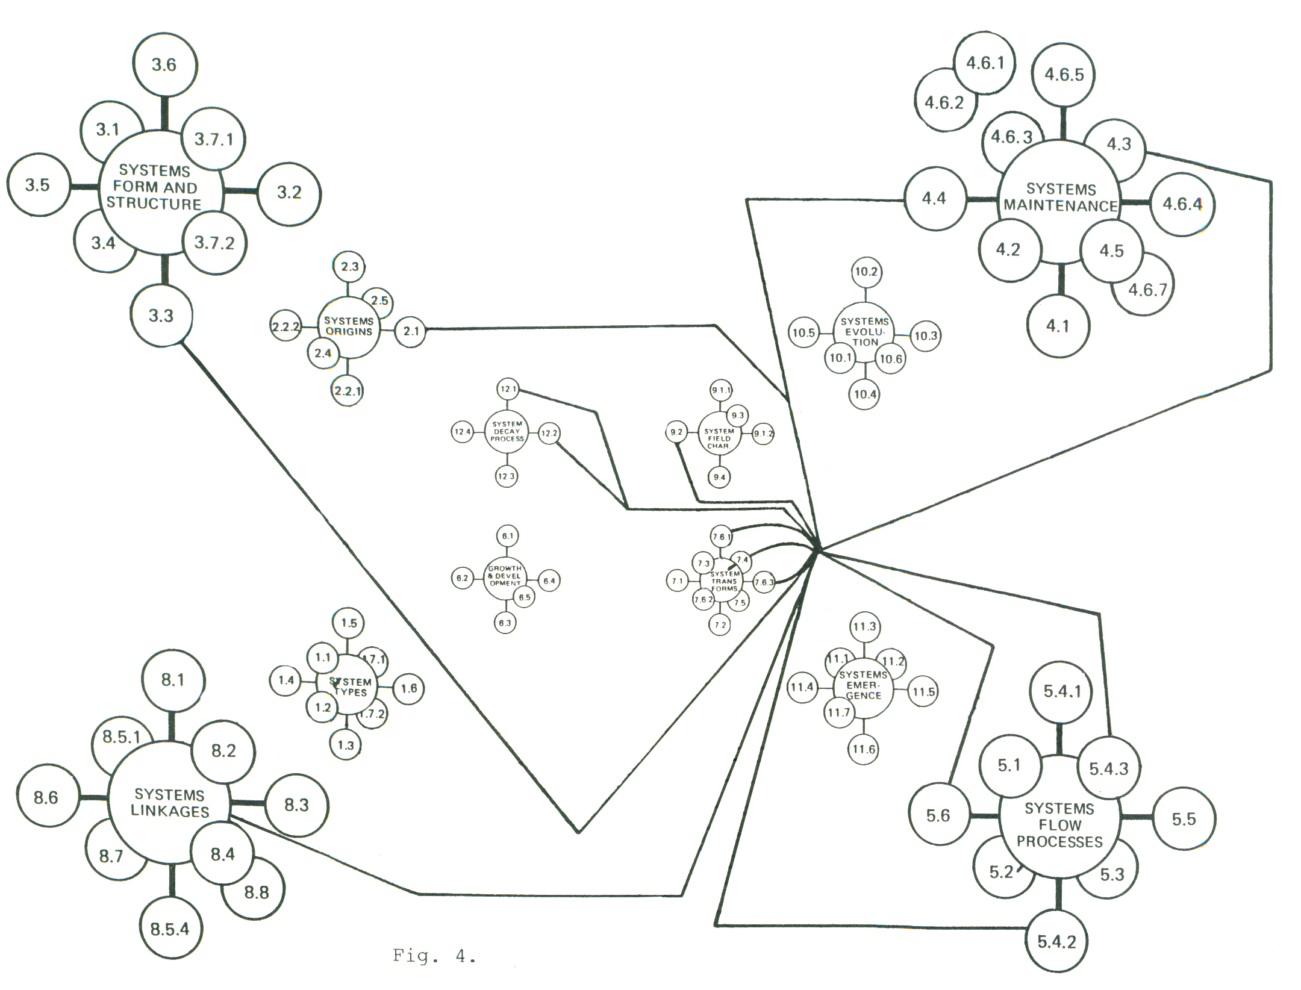
CYCLING PROCESSES: ONE TO MANY
Result when ask SPT-RDB to show only all LP’s operating on Cycling as an ISP.
Can click on any sphere or line to find out the data base info on that part of graph
In this way, the overall SPT NET is a graphic organization of the data + way to get to data + an At-A-Glance simplification of the massive data sets

Slide 41
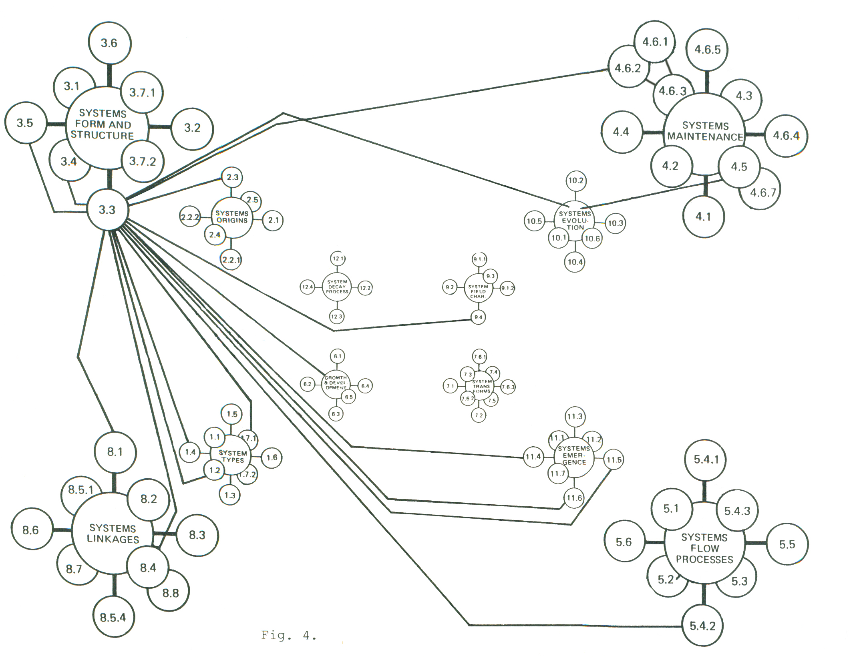
BOUNDARY PROCESSES: ONE TO MANY
Result when ask SPT-RDB to show only all LP’s operating on Boundary Processes as an ISP.
Can click on any sphere or line to find out the data base info on that part of graph
In this way, the overall SPT NET is a graphic organization of the data + way to get to data + an At-A-Glance simplification of the massive data sets

Slide 42
Or Ask Show Dependency & Prerequisite Chains
Since the knowledge base knows what ISPs are dependent on other ISPs, can also ask expert systems to show chains of dependency and identification of prerequisite processes
In this way, the overall SPT NET is a graphic organization of dynamics of systems and not just info on patterns or processes

