Slide 1
IS SS
20 17
SYSTEMS BIOLOGY
AS
SYSTEMS PATHOLOGY
Len Troncale, Past President, ISSS, 1990
Prof. Emeritus & Past Chair, Biology Dept., College of Science, Lecturer, M.S. in S.E., College of Engineering, Calif. State Polytechnic Univ., Pomona
lrtroncale@cpp.edu

Slide 2
CONTENTS/OUTLINE I.
What Is Systems Biology?
Basic details of microarrays, heat maps, & study of thousands of genes at one time; if that ain’t systems-level what is
Is Systems Biology Here to Stay?
New Breakthroughs Are Not Always Permanent
Evidence from Funding, Institutional Buy-In, Conference Series, Journals: A resounding YES
But Is It Conventional Science?
SysBio could be the elusive Bridge between the methods of Conventional & Systems Science
Initial Comparisons: SysBio & SysPath
What Could SysBio learn from SysPath?
What Could SysPath learn from SysBio?
Practical Initiatives going forward for these two ISSS SIG’s

Slide 3
WHAT IS SYSTEMS BIOLOGY?

Slide 4
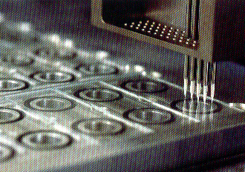
Briefest of Intro’s to Microarrays: How SysBio Gets To Whole Sys Level
Whole system for biology would be looking at ALL the genes & their activity at one time; tens of thousands of genes
Makes “spots” of a tiny drop of liquid as “reaction vessels”
How do you get as many as 20,000 spots on a slide? Two ways; both have to be explained here
Commercial; e.g. Affymetrix human, fly, etc. pre-prepared, but $100 each; many needed /exp’t; (story)
Make your own (CPP way); use robotic spotter shown here; describe each part shown
Start with 64 small wells each with millions of copies of a single DNA fragment (not shown)
Clean pins; robot dips pins in well and transfers drop of DNA (of whatever) to slide
Robot cleans & dries pins and re-dips in new wells
Robot moves precise distance away and re-deposits spots
Never gets tired; but does make mistakes; atlas

Slide 5
Microarrays Make Heat Maps
One micro-array slide typically can hold as many as 45,000 spots & so test the activity of 45,000 genes at one time. If each spot (usually a fragment of a gene) has only 1 DNA seq of 15 bp, it can pick out a precise match from more than 1 billion other seq’s! 4^{n} is = 4^{15 actually 1,073,741,824}

Slide 6
THE MEANING OF A “HEAT” MAP
Every spot above is a grid intersect of two axes (often one a gene, other a particular cell or cancer gene activity); in each spot, process TESTS for success or not of ”hybridization” (base pairing of two reactants)
Each small rectangle represents a “spot” on the microarray (as one of the reactants carries dye; lights if success
“Reader” measures the amount of hybridization for that spot; i.e. amount of product from that gene for the test sample via fluorescent probe; amount of fluorescence directly related to hybridization success
Called “heat” because reader assigns shades of yellow to red to represent increased state of production (promotion, or up-regulation, or turned on, or positive feedback)
Green represents decreased production (repression, down-regulation, turned off, or negative feedback
May use shades of grade for a spectrum of same in B&W
Overall, compares thousands of genes at same time for different levels of expression; great AT-A-GLANCE technique making reductionist into whole systems approach; reflects metabolic network

Slide 7
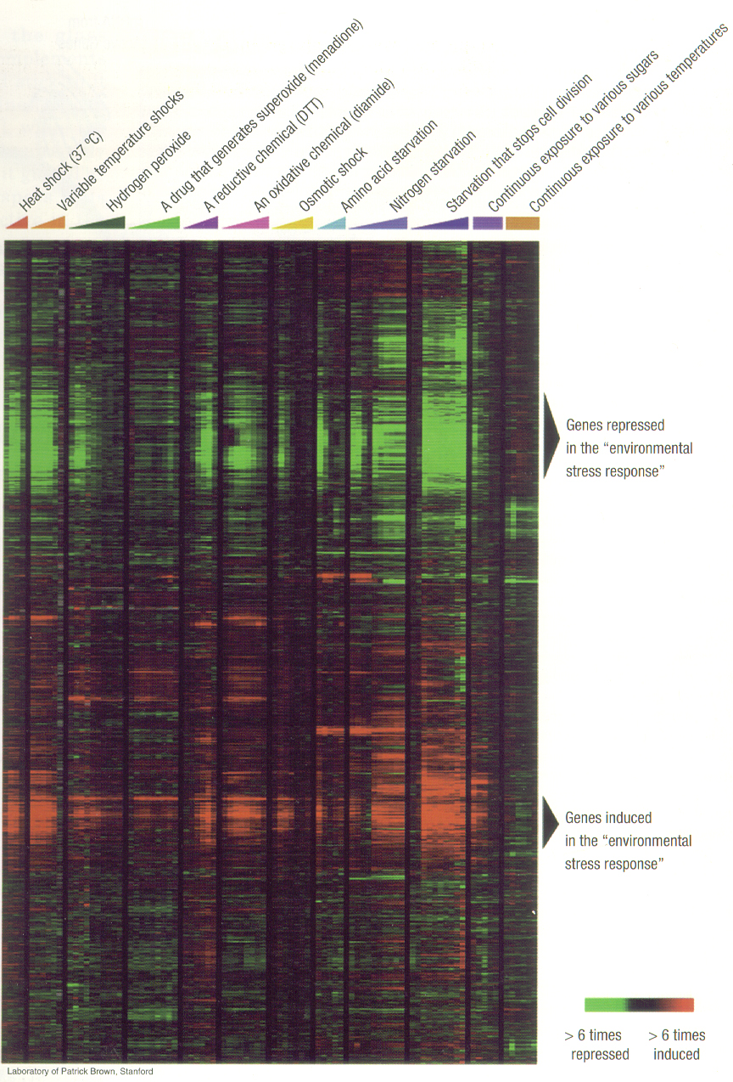
Microarrays & Heat Maps Reveal Whole Sys Changes
Use clever exp’ts to cluster or use software to group hierarchically as in taxonomy
Microarrays (explained next subsection) get data on activity of genes under different states and/or conditions
E.g. at left different stress conditions and its effects on many genes some up some down
Can see thousands of changes in one experiment
Results in massive data bases beyond human comprehension (my son → 2 GB of data per day!! That’s 10³⁰ units of info or 10⁹ bytes)
But how interpret; need new approach called “systems biology”

Slide 8
“Systems Biology” SYSTEMS PATHOLOGY already established
“Bottom-up” because at gene level, lowest level, from reductionist exp’t’l knowledge of the “particulars” without regard for the systems architectures, but SB looks at system
1st Eg. Systems Biology of Cancer
From my 4-hour lecture on it for Bio302
Individual genomics finds many mutated genes contribute to what conventionally thought to be one type of cancer
Sometimes >100 genes with many diff’ces between individuals w. same cancer
SB = ALL“drivers” & “passengers” for cancer
BUT HOW LOOK AT 100’s OF GENES AT ONCE →INTRO TO MICROARRAYs

Slide 9
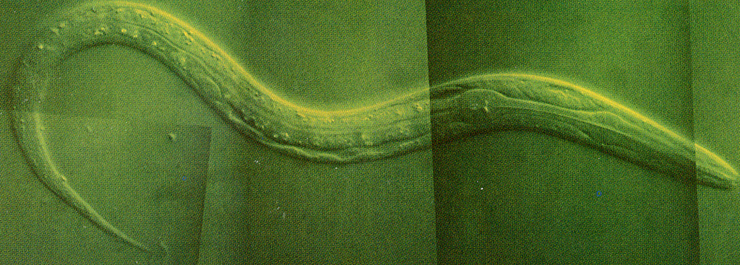
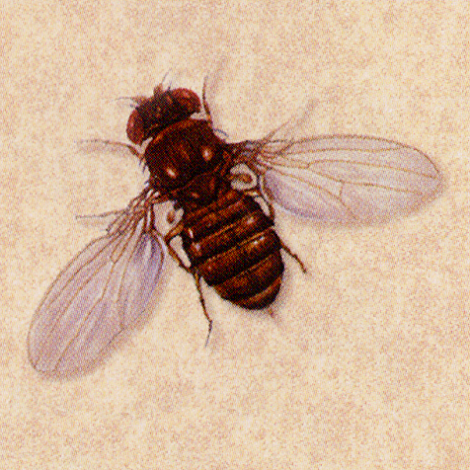
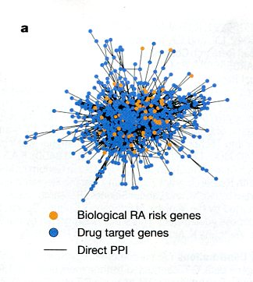
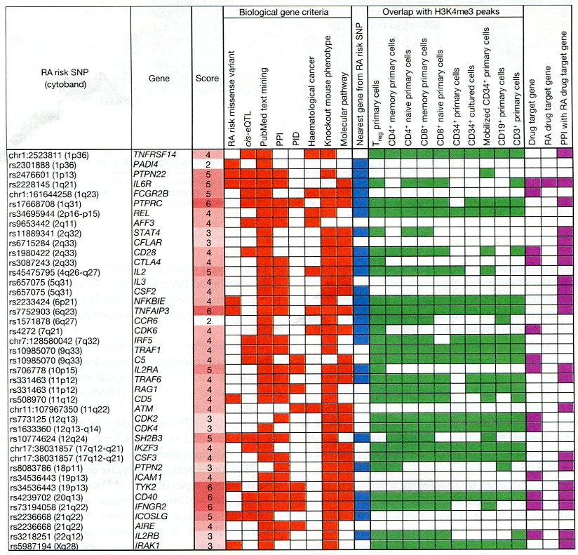
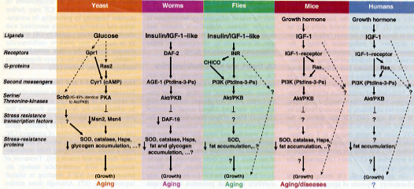
SYSTEMS BIOLOGY as SYSTEMS PATHOLOGY
These examples
based on concept of aging as accumulation of dysfunctions
➢2nd Eg. Systems Biology of Aging
From my 2-hour lecture on it for Bio328
Nematode: SB Id’d 164 age-regulated genes; Changes to gene activity of insulin pathway in yeast, nematode, fly, mouse can ↑ lifespan/longevity
For fly 885 genes show age regulation; all showed changes under calorie restriction which also ^ lifespan
Also applying systems biology to humans
Prediction of centenarian at 77% accuracy given genetic signature of 281 gene variants; no variant alone does
RA=rheumatoid arthritis; looked at 10M SNPs in 100K;
Found 42 new RA risk genes; so did 2nd SysBio study
Now 101 RA risk genes; 98/101 acted on same genes as known RA treatment drugs
Human Obesity decreases longevity; in 225K humans; found 49 genes (33 new) assoc’d w waist-hip ratio/BMI
Enables further metabolic pathway & network analysis

Slide 10
IS SYSTEMS BIOLOGY HERE TO STAY?

Slide 11
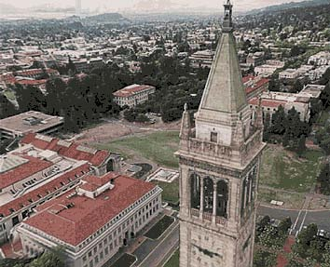
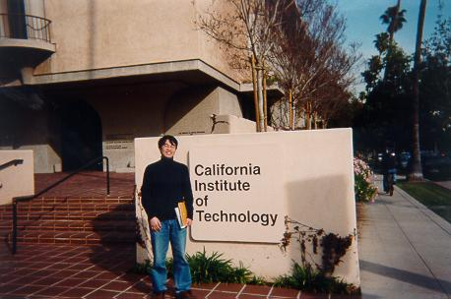
SYSTEMS BIOLOGY as SYSTEMS PATHOLOGY (two ISSS SIGs) I.
Is “Systems Biology” here to stay…? Evidence I. New Centers
UC, Berkeley
$ 100 million initiative
Caltech
$ 100 million
New Faculty

Slide 12
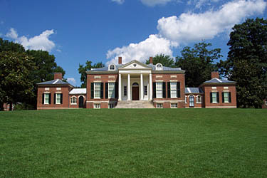
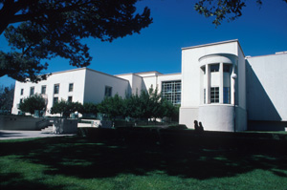
SYSTEMS BIOLOGY as SYSTEMS PATHOLOGY (two ISSS SIGs) II.
Is “Systems Biology” here to stay…? Evidence II. New Centers
Johns Hopkins
$ 34 million
Keck Graduate Institute, Claremont Colleges
$50 million

Slide 13
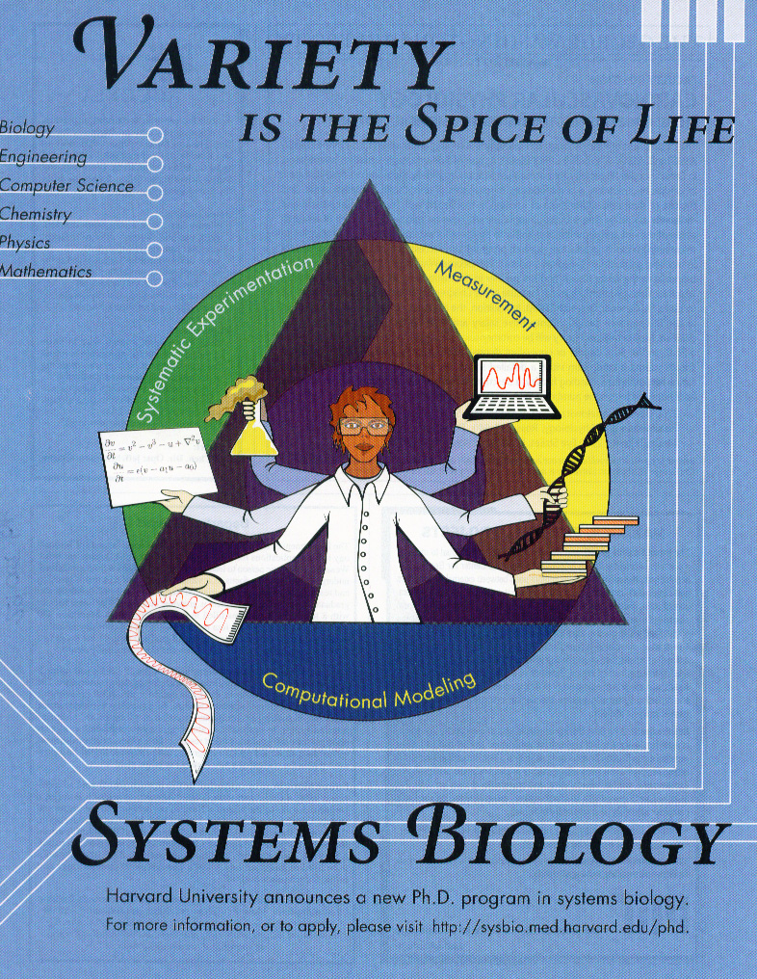
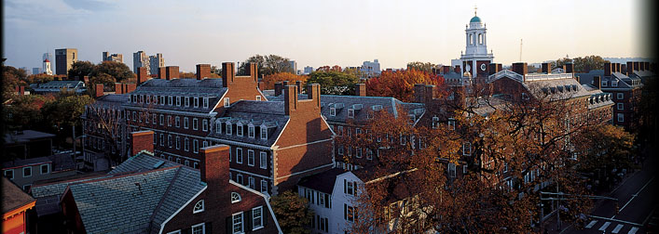
SYSTEMS BIOLOGY as SYSTEMS PATHOLOGY (two ISSS SIGs) III.
Is “Systems Biology” here to stay…? Evidence III. New Centers
Total of nearly half a billion dollars for only six major universities !!!
Princeton
$ 70 million
Harvard
$ 50 million
First new dept in medical school in three decades

Slide 14
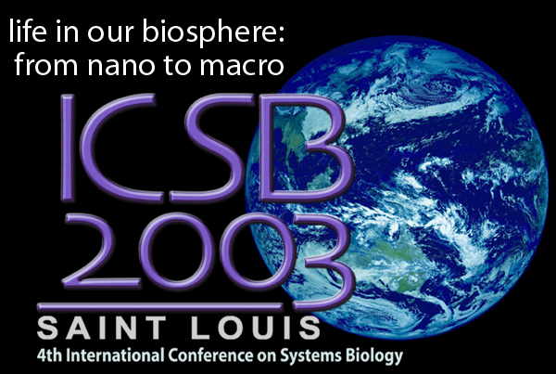
SYSTEMS BIOLOGY as SYSTEMS PATHOLOGY (two ISSS SIGs) IV.
Is “Systems Biology” here to stay…? Evidence IV. New Conference Series
2001 JAPAN
2002 CALTECH
Boston

Slide 15
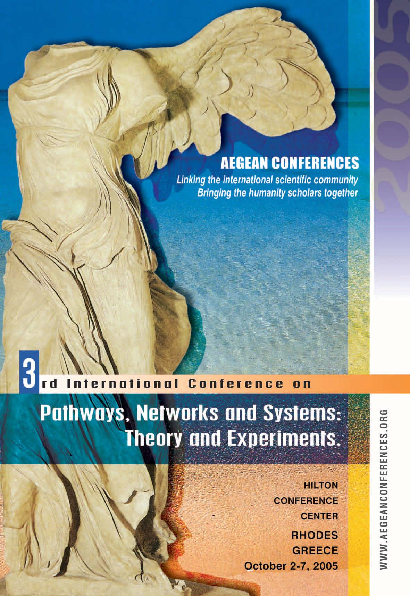
SYSTEMS BIOLOGY as SYSTEMS PATHOLOGY (two ISSS SIGs) V.
Is “Systems Biology” here to stay…? Evidence V. New Conference Series
Joe Nadeu, Chair, Medical Genetics, Case Western
Greek Island series…….
Characterized by more intense discussion sessions
Regular conference attendee’s; more Europeans

Slide 16
SYSTEMS BIOLOGY as SYSTEMS PATHOLOGY (two ISSS SIGs) VI.
Is “Systems Biology” here to stay…? Evidence VI. New Conference Series
Fifth International Conf. on Complex Systems
Boston, May, 2004
Several Systems Biology Plenaries, Paper, & Poster Sessions
Tightly coupled with major New England universities
Harvard, MIT, Yale…
Sante Fe Institute
Scaling laws, network dynamics, biocomputation, artificial life simulations, etc.
NECSI

Slide 17
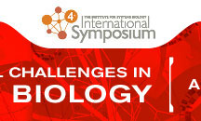
SYSTEMS BIOLOGY as SYSTEMS PATHOLOGY (two ISSS SIGs) VII.
Is “Systems Biology” here to stay…? Evidence VII. New Conference Series
Cold Spring Harbor Lab Mtgs: on Systems Biology in March’05
Systems & Biology: Joint Mtg with Proteomics/Bioinformatics, Apr’05
Systems Biology joins very established disciplines of Conventional Biology and Computer Science

Slide 18
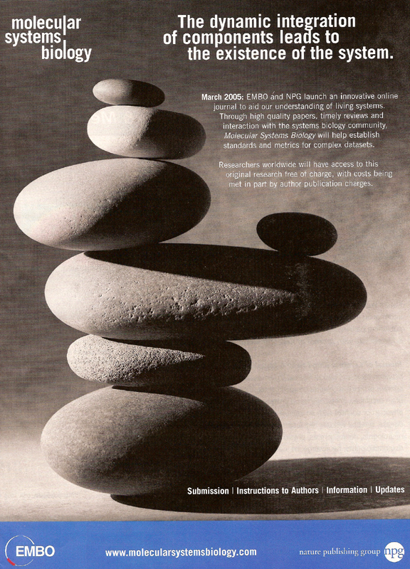
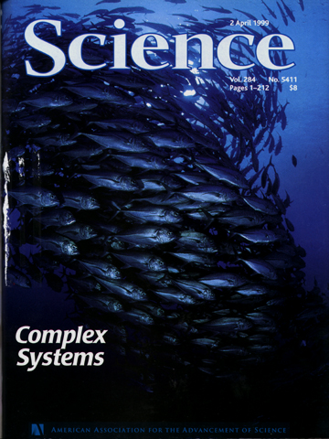
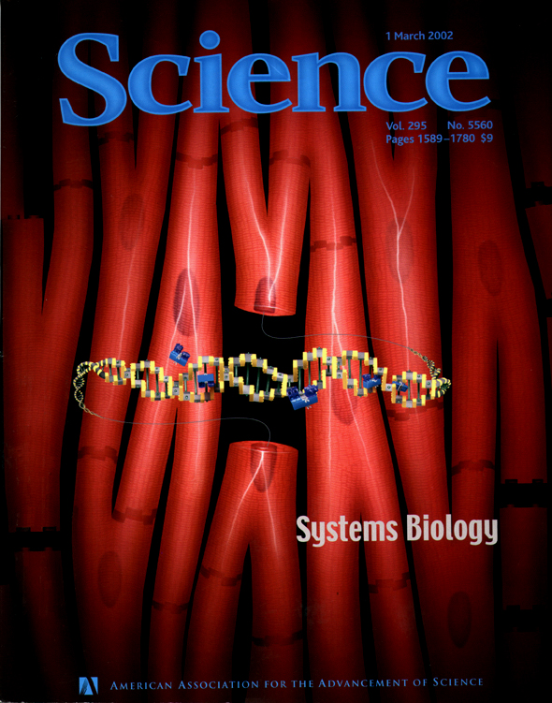
SYSTEMS BIOLOGY as SYSTEMS PATHOLOGY (two ISSS SIGs) VIII.
Is “Systems Biology” here to stay…? Evidence VIII. New Journals
EMBO = European Molecular Biology Organization
Newest Journal
Completely on Molecular Systems Biology
Science special issue, April ‘99
Science special issue, March ‘02
Predict soon Annual Review of Systems Biology

Slide 19
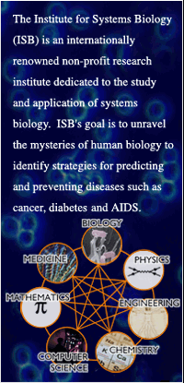
SYSTEMS BIOLOGY as SYSTEMS PATHOLOGY (two ISSS SIGs) IX.
Is “Systems Biology” here to stay…? Evidence IX. New Companies
Lee Hood, Formerly of Caltech & Univ. of Washington
“Father” of high throughput tools; left both to found…
Institute for Systems Biology
$140 million; 170 staff
He and his wife
Awarded $M NSF grants
to teach systems biology in high schools of Washington area
Fateful lunch Hood helps my IAS get $1.3M → my ISGE
MORE EVIDENCE & RELEVANCE IF YOU NEEDED IT .......
My Yrs of collecting job announcements in Systems Biol
MYPLAN: Invite all SysBiol’s to ISSP
Do you now see Systems Biology as Systems Pathology?
Because it is interdisciplinary; yields new results for curing diseases; tries to understand the whole system; powerful

Slide 20
SYSTEMS BIOLOGY POSITION ON SPECTRUM OF STh TO SysSci

Slide 21
Two Axis Spectrum: SysDomain Positions: (Better than Opposing Camps at War)
> Abstract
> Messy/Complex
> Isomorphs
Troncale SPT
Forrester SysDyn
ISM Warfield
Odum SysEcol
SSM Checkland
Systems
Thinking
Systems
Science
Phys CAS
Miller LST
CSM Jackson
Math ST
SysPhilos
Systems Biology
Earth SysSci
Why are the terms “thinking” and “science” used virtually interchangeably if there is a difference in position spectrum of systems work?
ChemSysSci
Med/Gen/Imm
> SciMeth
> HumanSysFocused
> Quant
> Qualit
> NatSys
> NoSciMeth/SciCitations
> Isomorphs

Slide 22
COMPARING SYSTEMS BIOLOGY TO GST/SysSci & SYSTEMS PATHOLOGY

Slide 23
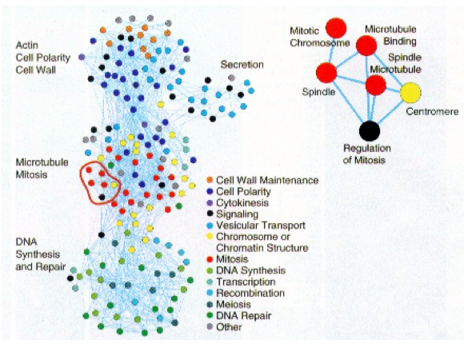
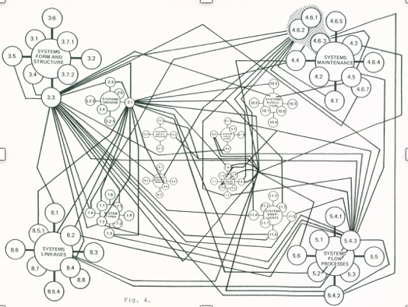
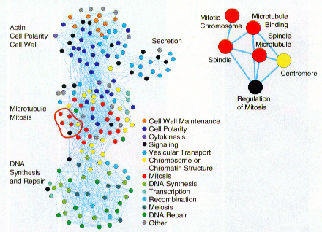
Comparing Systems Biology to Systems Pathology I.
The graphic shown at right is one of many now appearing frequently in the growing field of systems biology (Tong et. al., 2004, Science, 303: 808).
It illustrates, at a basic level, some of the similarities and possible mutualities between systems biology and systems pathology.
The graphic at the left below shows a set of linkage propositions that describe mutual influences among systems processes common to many systems. It is a typical graphic of the SPT from which Systems Pathology is derived. This “system of systems processes” (SoSP) is another developed precedent for a new discipline of systems pathology.
SB & SP have several similarities as described in the next slide.
Systems Biology could be tested to suggest new general linkages to the SPT; SoSP could be mined for new hypotheses for Systems Biology or for explanations of emergent systems-level phenomena.

Slide 24
Comparing Systems Biology to Systems Pathology II.
Both have many nodes, with each node itself a complex of processes.
Both have many interactions and combinations of interactions.
Both exhibit the the range of dynamics typical of complex systems, and are amenable to its tools and methods as a result of this complexity.
Both have massive underlying data sets requiring computers for use.
Both have extensive refereed literatures to support the interactions.
Both are inherently “complex networks” enabling application of and discovery of general network theorems of structure and interaction.
One key dissimilarity: the graphic above represents a very specific system manifestation, while the one below represents “systemness” in general; it has been integrated from studies of many specific systems.
GENERAL OBSERVATION: Biology is a reductionist science; SysPath must be > holistic; as a result, until recently, SB & SP would be at odds, BUT…

Slide 25
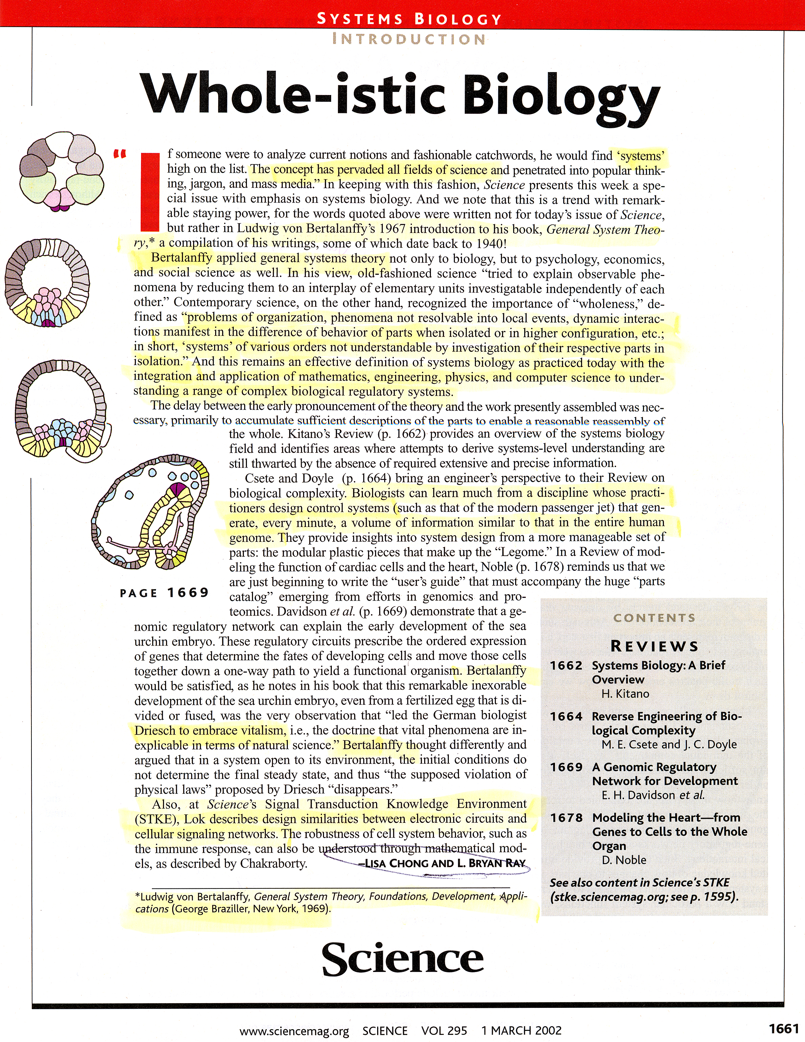
BUT NOW Change in Natural Science Attitude
March 2002
Actual citation of GST & Sys Bio & Bertalanffy by natural scientists in most read sci journal in world in 8 places
Cover & articles on Systems Biology & general systems approaches like SYS PATH

Slide 26
SYSTEMS BIOLOGY LEARNS FROM SYSTEMS PATHOLOGY

Slide 27
SYSTEMS PATHOLOGY LEARNS FROM SYSTEMS BIOLOGY

Slide 28
PRACTICAL FUTURE PLANS FOR TWO ISSS SIG’s (SysBio & SysPath)

